Slide 1

Databricks Certified Data Engineer Associate Crash Course
Tim Warner

Slide 2

Tim Warner
Based in Nashville, TN, US
26-year Microsoft Certified Trainer (MCT)
6-year Microsoft Most Valuable Professional (MVP) in Azure AI and Cloud & Datacenter Management
Connect: timw.info/linkedin

Slide 3
Agenda
Introduction
Review the Databricks Data Engineer Associate exam’s technical content
Strategize the exam
Generative AI
Practice questions

Slide 4
Course Materials
timw.info/databricks

Slide 5
Level Setting
The focus areas of the Databricks Data Engineer Associate:
Practitioner-level skills with Databricks
The data engineer’s scope of work
I’m here to answer your questions – take advantage of this!
Please use the Q&A panel for questions and feedback

Slide 6
Break Schedule (Central Time)
07:00am - Start
08:00am - 9-min break
09:00am - 9-min Break
10:00am - 9-min Break
11:00am - 9-min Break
12:00pm - Finish

Slide 7
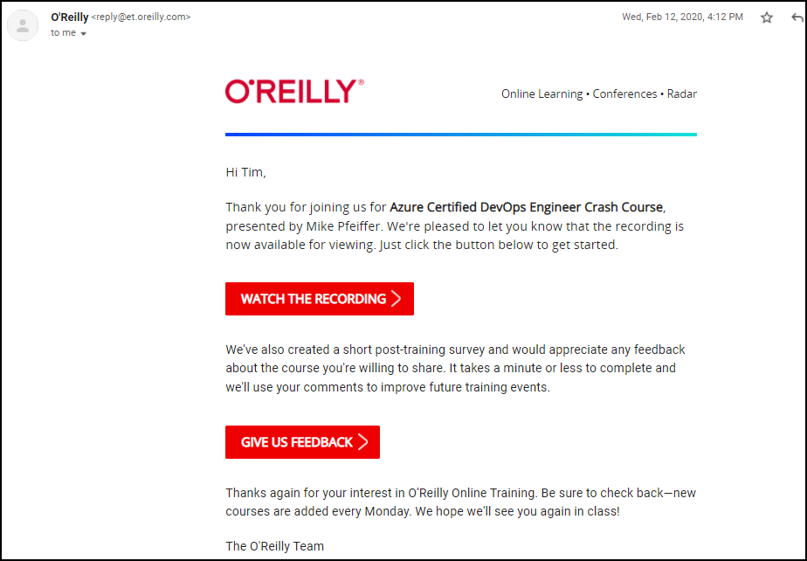
Session Recordings

Slide 8

Session Recordings

Slide 9

Session Recordings

Slide 10


Mobile Browser: learning.oreilly.com

Slide 11



O'Reilly Mobile App

Slide 12

Tim’s IT Certification Study Model

Slide 13
Thank you!
Course materials: timw.info/databricks
LinkedIn: timw.info/linkedin

Slide 14
About the Exam

Slide 15
Data Fundamentals

Slide 16
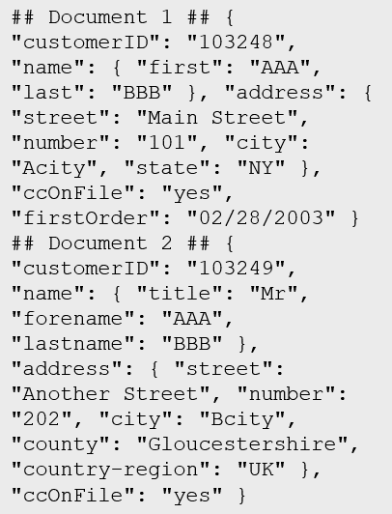
Data Types
Structured
Semi-structured
Unstructured
Table

Slide 17

Data Workload Types
Online Transactional Processing (OLTP)
Online Analytical Processing (OLAP)
Customer
CustomerID | CustomerName | CustomerPhone
Orders
OrderID | CustomerID | OrderDate
Data is periodically loaded, aggregated and stored in a cube
Data is stored one transaction at a time

Slide 18

Data Processing Types
Batch
Streaming

Slide 19
Data Processing

Slide 20
ETL
Azure Data Factory
Azure Stream Analytics

Slide 21
ELT
Azure Data Factory
Azure Synapse

Slide 22





Data Analytics
On-premises data
SQL Server, Oracle, fileshares, SAP
Data ingestion
Data storage
Data processing
Data visualization
Cloud data
Azure, AWS, GCP
SaaS data
Salesforce, Dynamics

Slide 23
Non-Binary Data Formats
CSV
Good for bandwidth-sensitive data loads
JSON
Clear, structured format with optional validation

Slide 24
Binary Data Formats
Optimized for splitting across compute nodes
Parquet, ORC: Columnar store
Fast read performance (compression) for analytical workloads
Avro: Row-based store that includes JSON
Schematized
Optimized for write performance

Slide 25
Blob Storage and Data Lake

Slide 26
Azure Blob Storage
Block blobs
Page blobs
Append blobs
Has a maximum size of 4.7TB
Best for storing large, discrete, binary objects that changes infrequently
Each individual block can store up to 100MB of data
A block blob can contain up to 50000 blocks
Can hold up to 8TB of data
Is organized as a collection of fixed sized-512 byte pages
Used to implement virtual disk storage for virtual machines
The maximum size is just over 195GB
Is a block blob that is used to optimize append operations
Each individual block can store up to 4MB of data

Slide 27
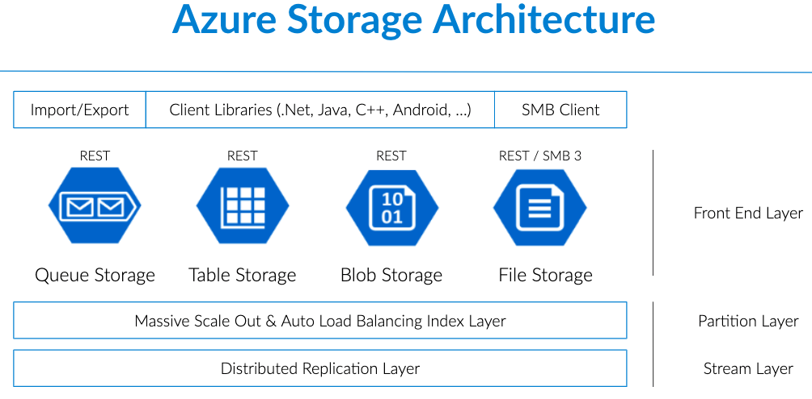
Blob Storage

Slide 28

ADLS Gen 2
A repository of data for your Modern Data Warehouse
Organises data into directories for improved file access
Supports POSIX and RBAC permissions
It is compatible with Hadoop Distributed File System
Store
Azure Data Lake Storage
High performance data lake available in all 54 Azure regions

Slide 29

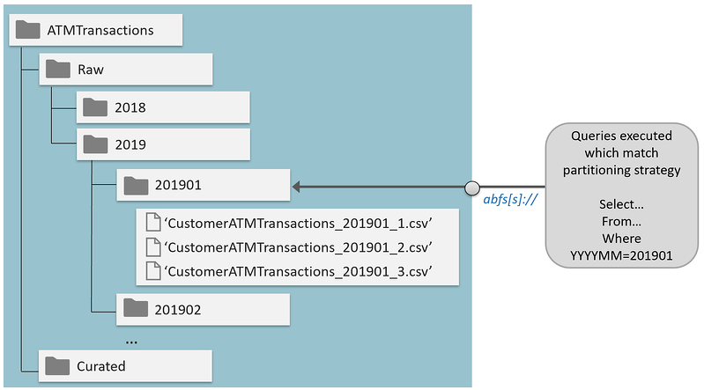
Data Lake Storage Gen 2

Slide 30
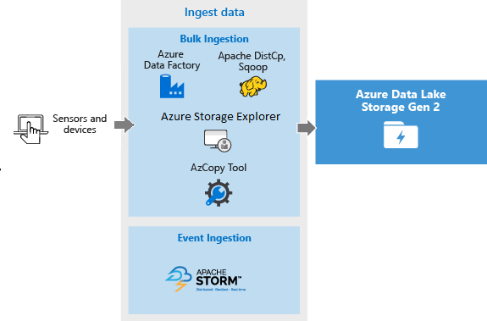
Azure Data Lake Storage Gen 2

Slide 31
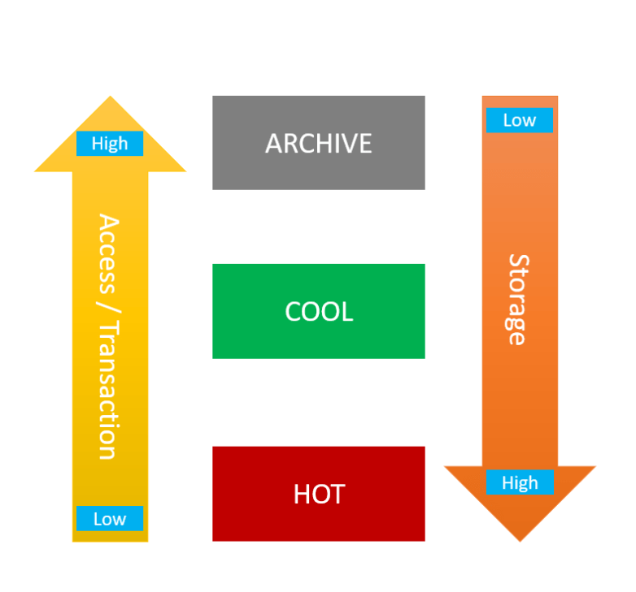
Access Tiers & Lifecycle Management

Slide 32
Databricks CLI
# Install the CLI
pip install databricks-cli
# Authenticate to Databricks host
databricks configure --token
# List available clusters
databricks clusters list
# Create a new cluster
databricks clusters create --json-file=create-cluster.json
# List available jobs
databricks jobs list
# Run a job
databricks jobs run-now --job-id <job-id>
# Upload a file to DBFS (Databricks File System)
databricks fs cp local-file-path dbfs:/destination-path

Slide 33
Dbutils Python Package
# Import dbutils (Databricks utility module)
from pyspark.dbutils import DBUtils
# Create a text widget
dbutils.widgets.text("input", "default", "Enter a value")
# Get the value of the widget
input_value = dbutils.widgets.get("input")
# List files in a directory
files = dbutils.fs.ls("/databricks-datasets")
display(files)
# Run another notebook and capture the result
result = dbutils.notebook.run("/path/to/notebook", 60, {"param1": input_value})
# Print the result of the notebook run
print(result)
# Clean up by removing the widget
dbutils.widgets.removeAll()

Slide 34
Spark SQL within PySpark
# Apache Spark SQL module
# Import necessary libraries
from pyspark.sql import SparkSession
from pyspark.sql import Row
# Initialize Spark session
spark = SparkSession.builder.appName("Spark SQL Example").getOrCreate()
# Create a DataFrame
data = [Row(name="Alice", age=30), Row(name="Bob", age=25), Row(name="Cathy", age=27)]
df = spark.createDataFrame(data)
# Register the DataFrame as a temporary table
df.createOrReplaceTempView("people")
# Run a Spark SQL query
result = spark.sql("SELECT name, age FROM people WHERE age > 26")
# Show the result
result.show()
# Stop the Spark session
spark.stop()

Slide 35
PySpark
# PySpark is the Python API for Apache Spark
# Write Spark apps in Python
from pyspark.sql import SparkSession
# Initialize Spark session
spark = SparkSession.builder.appName("PySpark Example").getOrCreate()
# Create a DataFrame
data = [("Alice", 30), ("Bob", 25), ("Cathy", 27)]
columns = ["name", "age"]
df = spark.createDataFrame(data, columns)
# Perform DataFrame operations
df_filtered = df.filter(df.age > 26)
df_filtered.show()
# Stop the Spark session
spark.stop()

Slide 36
Databricks Notebook Magic Commands
# MAGIC %python
# Create a DataFrame
data = [("Alice", 30), ("Bob", 25), ("Cathy", 27)]
columns = ["name", "age"]
df = spark.createDataFrame(data, columns)
df.createOrReplaceTempView("people")
# MAGIC %sql
-- Run a SQL query
SELECT name, age FROM people WHERE age > 26;
# MAGIC %fs
# List files in a directory
ls /databricks-datasets

Slide 37
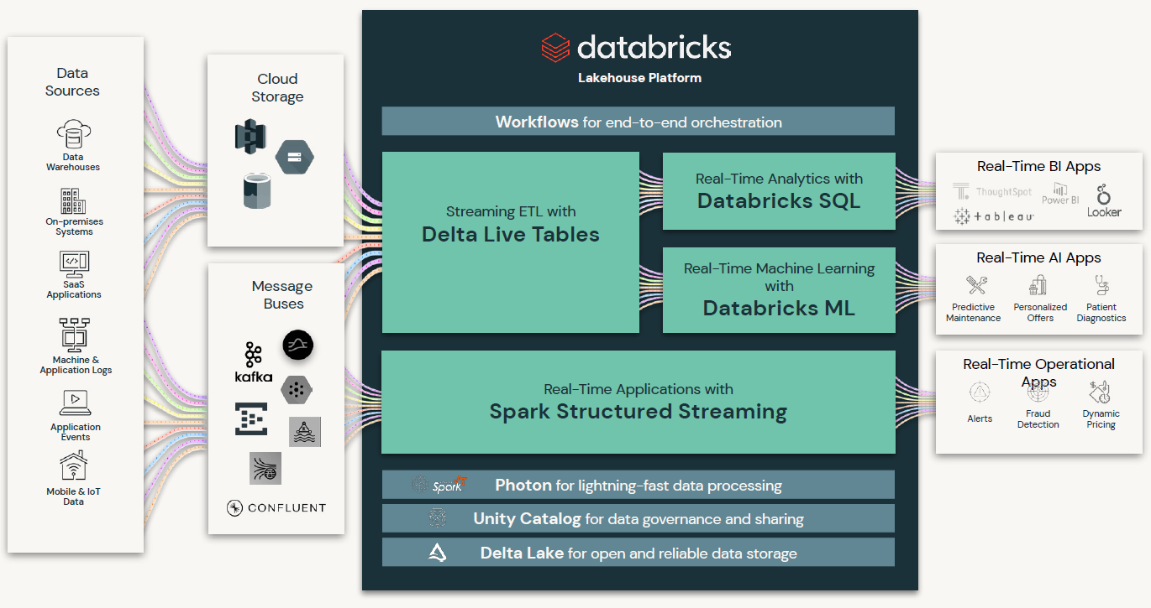
Databricks Integration

Slide 38
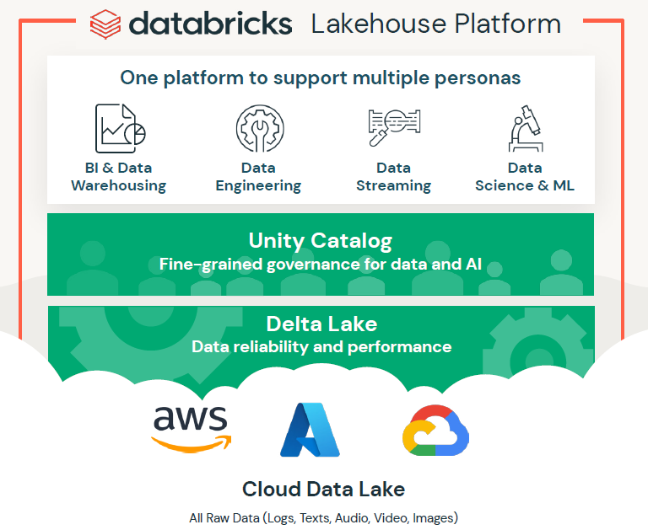
Databricks Marketing Pitch

Slide 39
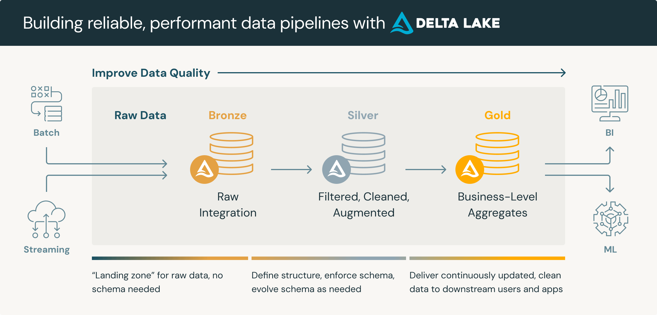
Medallion Architecture

Slide 40
Delta Lake
Enhances Spark with ACID transactions, schema enforcement, and the ability to handle massive datasets, making it ideal for large-scale data warehousing needs.

Slide 41
Practice Questions

Slide 42
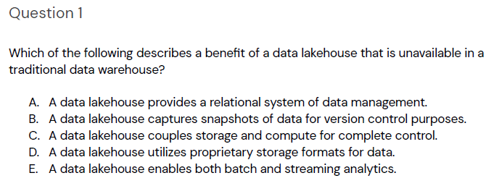
Practice Question #1
Source: academy.databricks.com
Correct answer: E. A data lakehouse enables both batch and streaming analytics. Unlike traditional data warehouses, a data lakehouse supports real-time data processing alongside batch processing, allowing for more flexible and timely data analytics.

Slide 43
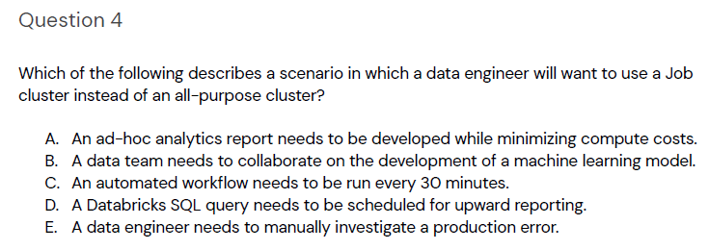
Practice Question #2
Source: academy.databricks.com
Correct answer: C. A Job cluster is ideal for scenarios where compute resources are required only for the duration of the job, as it helps minimize costs by spinning up clusters specifically for scheduled or recurring tasks. This makes Job clusters particularly suitable for automated workflows that run at regular intervals, such as every 30 minutes.

Slide 44
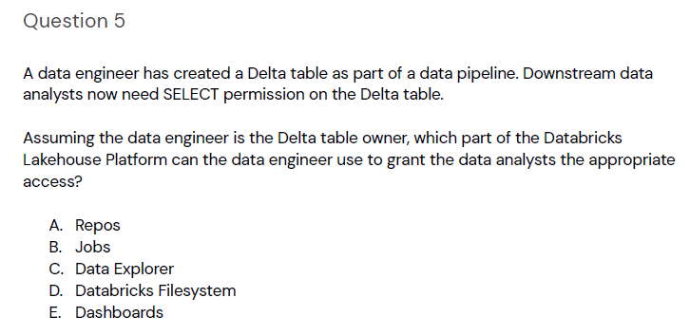
Practice Question #3
Source: academy.databricks.com
Correct answer: C. Data Explorer in Databricks allows the table owner to manage permissions, enabling the data engineer to grant SELECT permissions to downstream data analysts on the Delta table.

Slide 45
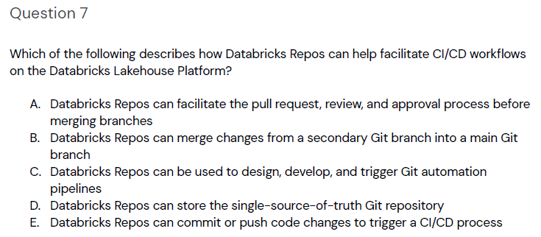
Practice Question #4
Source: academy.databricks.com
Correct answer is C. Databricks Repos integrate with Git to facilitate the continuous integration and continuous delivery (CI/CD) process, allowing users to design, develop, and automate the deployment of code changes through Git workflows.

Slide 46
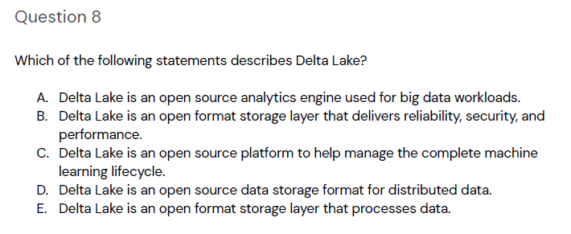
Practice Question #5
Source: academy.databricks.com
The correct choice is B. Delta Lake is an open format storage layer that delivers reliability, security, and performance.Delta Lake enhances the capabilities of data lakes by providing a robust storage layer that ensures data integrity and high performance through features like ACID transactions, schema enforcement, and support for large-scale data processing.

Slide 47
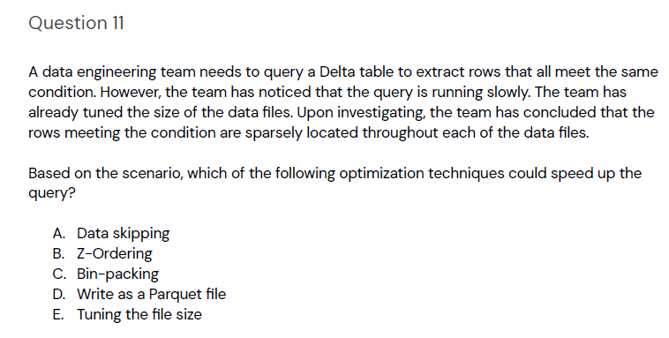
Practice Question #6
Source: academy.databricks.com
Correct answer is B. Z-Ordering improves query performance by co-locating related rows in the same file, which helps reduce the amount of data scanned during query execution. This is especially useful when the rows meeting the condition are sparsely located, as it ensures they are organized more efficiently on disk.

Slide 48
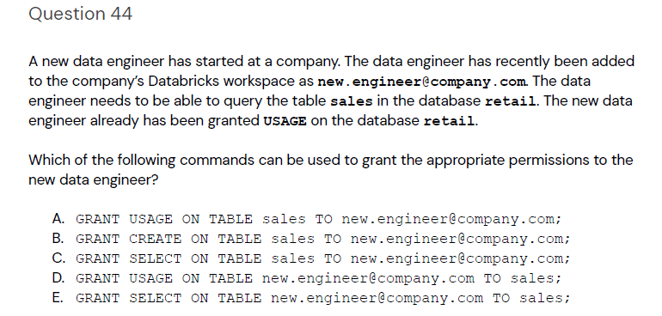
Practice Question #7
Source: academy.databricks.com
Correct answer is C. The GRANT SELECT command provides read access to the specified table, which is necessary for the data engineer to query it. This permission allows the user to execute SELECT statements on the sales table within the retail database, aligning with the required query capabilities.

Slide 49
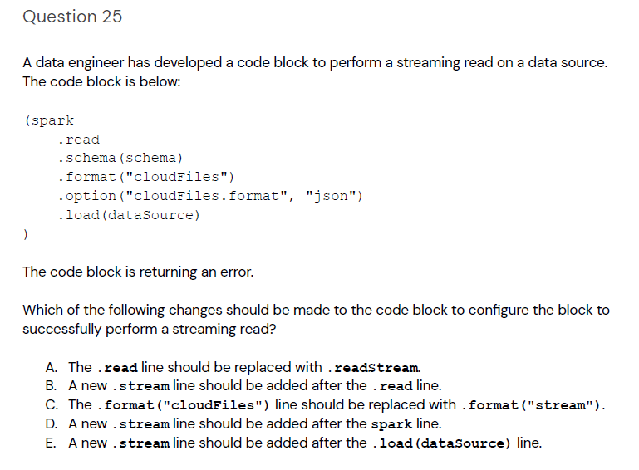
Practice Question #8
Source: academy.databricks.com
Correct answer is A. The `.read` method is used for static data reads, whereas `.readStream` is required for streaming reads to handle continuous data input. Replacing `.read` with `.readStream` will enable the code block to process streaming data as intended.

Slide 50
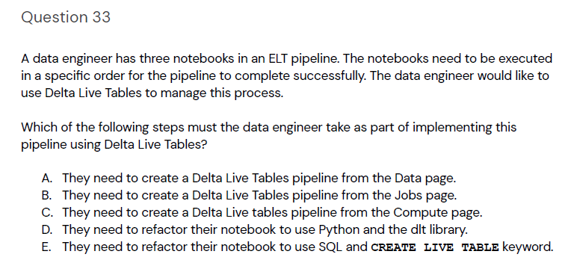
Practice Question #9
Source: academy.databricks.com
Correct answer is B. Creating a Delta Live Tables pipeline from the Jobs page allows the data engineer to schedule and manage the execution of notebooks in a specific order. This is essential for ensuring that the ELT pipeline runs as intended and maintains the correct data processing sequence.

Slide 51
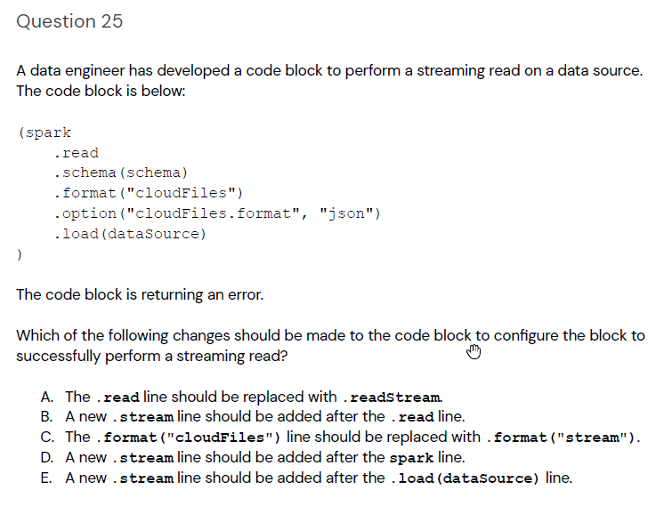
Practice Question #10
Source: academy.databricks.com
Correct answer is A. The `.read` method is intended for static data sources, while `.readStream` is designed for continuous data streams. Replacing `.read` with `.readStream` allows the code block to handle streaming data efficiently, which is necessary for real-time data processing in this context.

Slide 52
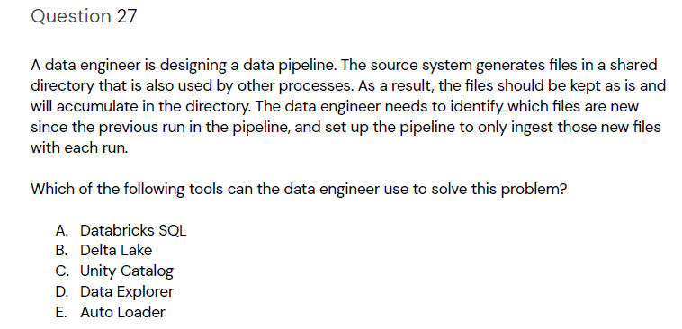
Practice Question #11
Source: academy.databricks.com
Correct answer is E. Auto Loader in Databricks is designed to efficiently load new data as it arrives in a directory, automatically tracking which files have been processed. This allows the pipeline to continuously ingest only new files, simplifying data management and ensuring that no duplicate data is processed.

Slide 53
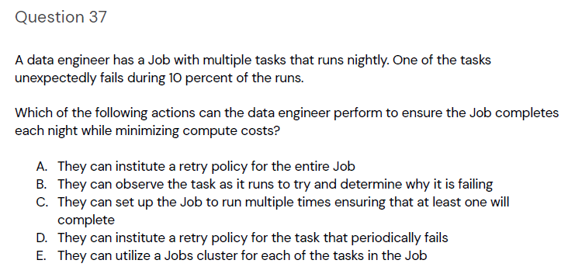
Practice Question #12
Correct answer is D. Instituting a retry policy specifically for the task that periodically fails minimizes compute costs by not redundantly retrying tasks that are already successful. This approach targets the failing task directly, ensuring the job completes while efficiently using compute resources.
Source: academy.databricks.com
Correct answer is D. Instituting a retry policy specifically for the task that periodically fails minimizes compute costs by not redundantly retrying tasks that are already successful. This approach targets the failing task directly, ensuring the job completes while efficiently using compute resources.

Slide 54
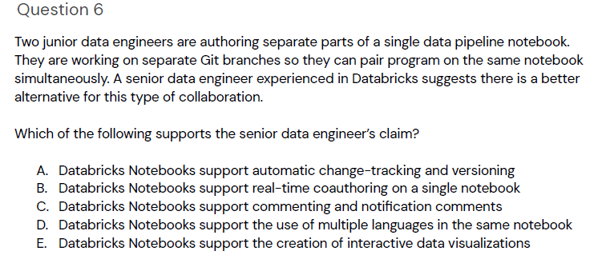
Practice Question #13
Source: academy.databricks.com
Correct answer is B. Databricks Notebooks support real-time coauthoring, allowing multiple users to edit the same notebook simultaneously. This feature facilitates effective collaboration and eliminates the need for separate Git branches for simultaneous work, improving workflow and efficiency.

Slide 55
Practice Question #X
Source: academy.databricks.com
Correct answer is X.

